Slide 1
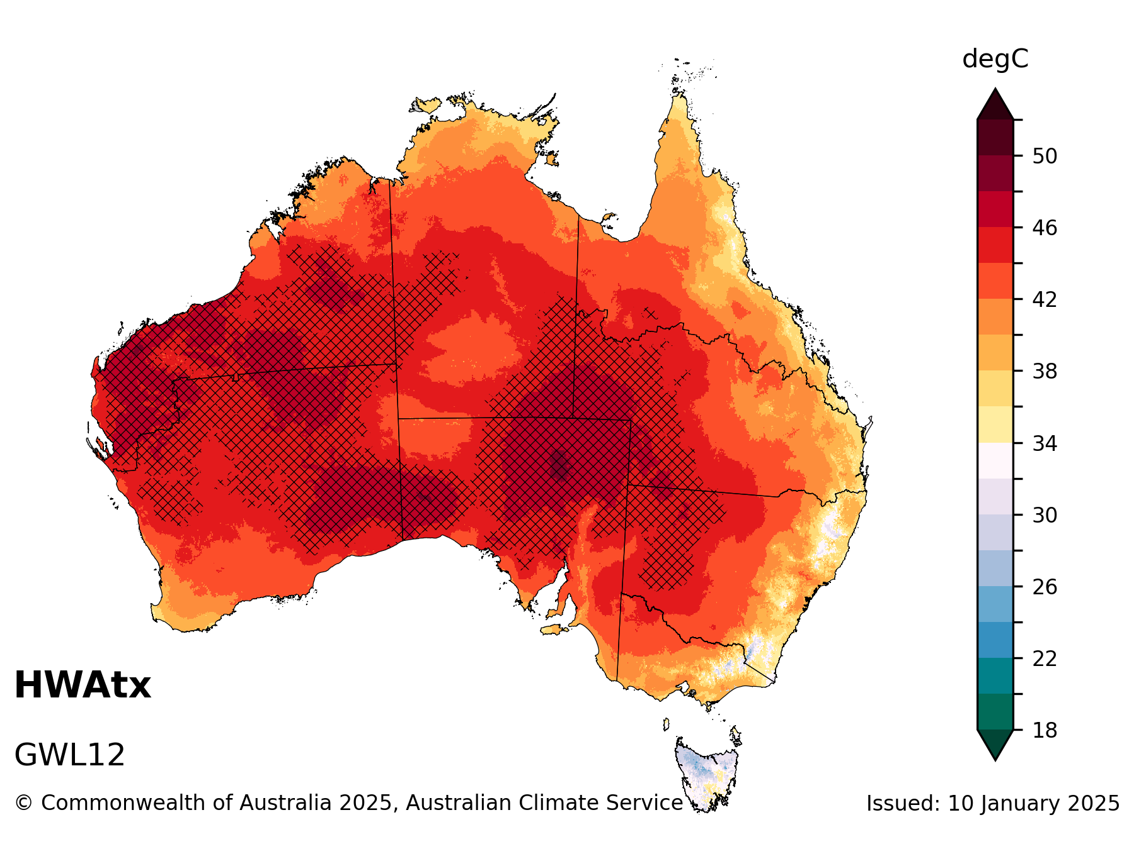
ACS hazard maps and stats
https://github.com/AusClimateService/plotting_maps
Summary of Gen Tolhurst’s Python resources for ACS Hazards
(May 2024 – Jan 2025)
[github link]

Slide 2
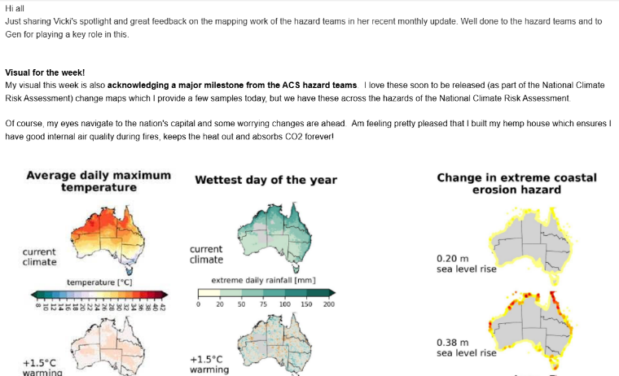
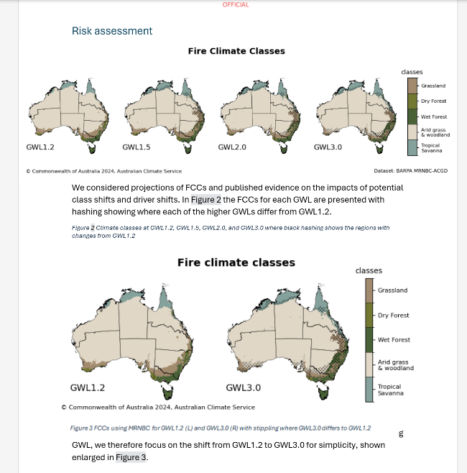
Achievements/ outcomes
Reinforce relationships with ABS by providing time series data (July 2024)
Reinforce trust and reliability of our science to government ministers through presenting consistent and branded maps for briefing (August 2024)
Enable easier interpretation and comparison through consistent maps for Climate hazards report (Sep 2024)
Improved accessibility through developing colourblind friendly colormaps
Align visualisations with ACS guidelines (Sep 2024)
Maps celebrated in Vicki Woodburn’s ACS “visual of the week” (Oct 2024)
Apply functions to plot figures for scientific publications (Oct 2024)
Improved efficiency of scientists by providing easy-to-use and flexible code
Wide uptake of code from many hazard teams and positive feedback
Provide expertise to Data61 for INDRA Hazard Portal (Dec 2024)

Slide 3
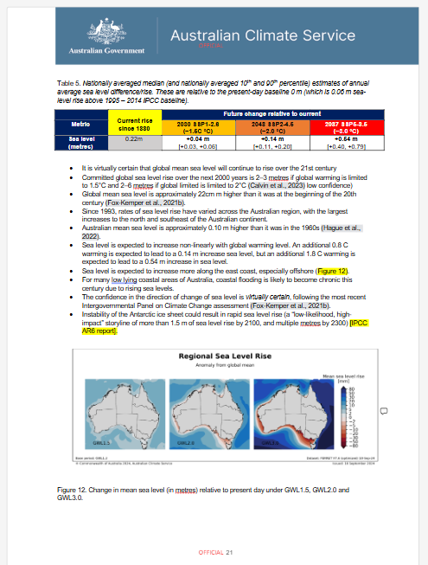
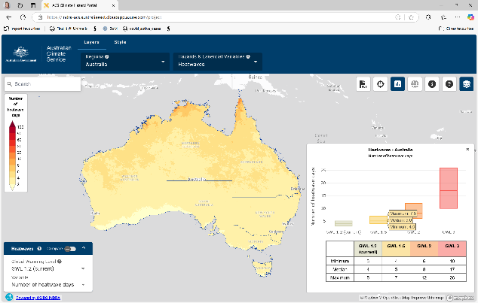
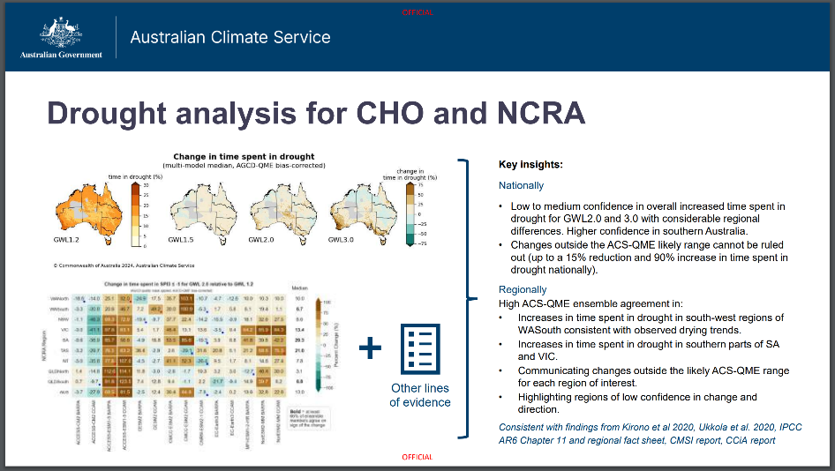
Outputs delivered
DCCEEW briefing maps and stats (July 2024)
ABS request for time series at points (July 2024)
Climate Hazards Overview report (Sep 2024)
ACS story map plots (Oct 2024)
INDRA Portal prototypes and advice (Nov 2024)
Hazard ensemble heatmaps data
Detailed documentation and easy-to-use and flexible functions freely available to all

Slide 4
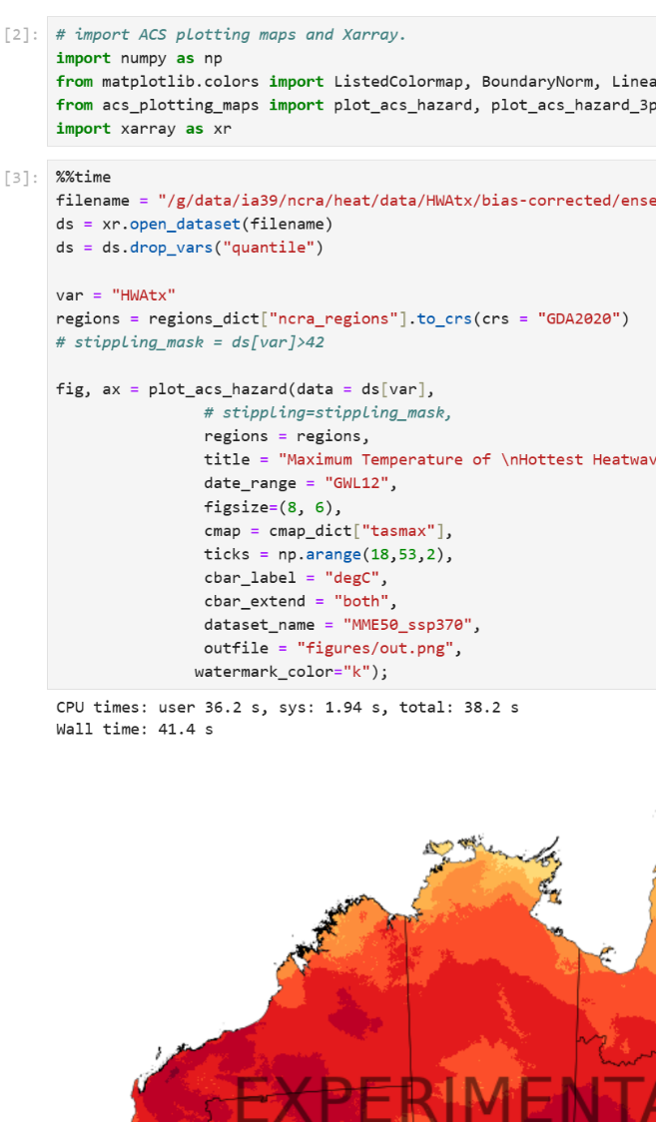
Tools
Python module for plotting
Python module for area-averaged statistics
Masks (shapefiles) for Australian regions
Detailed documentation including Getting Started guide, FAQs, and examples of what’s possible
Jupyter notebooks of examples and code for reports and requests.
Development issues for past and future improvements

Slide 5
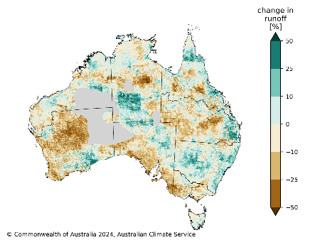
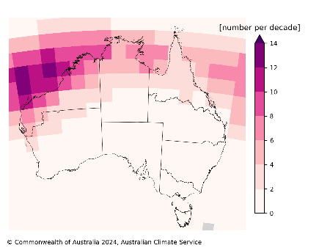
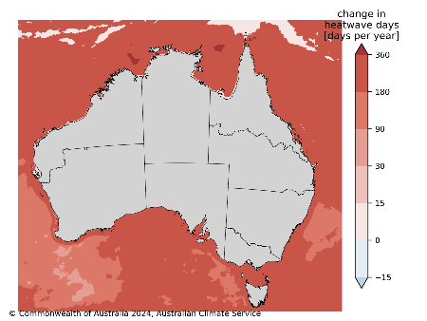
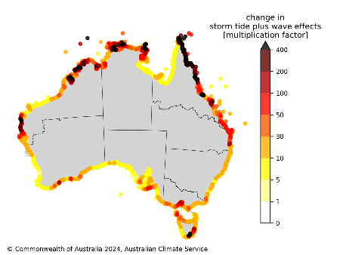
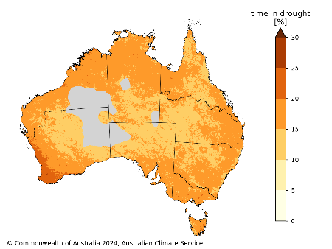
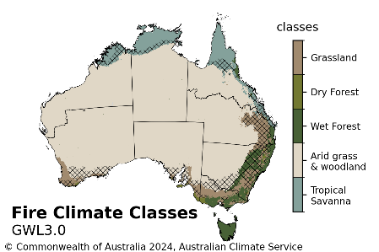
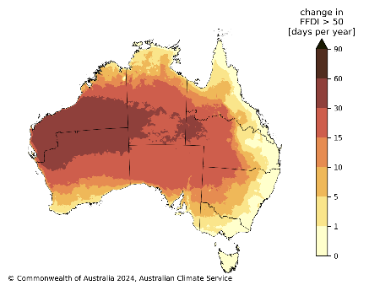
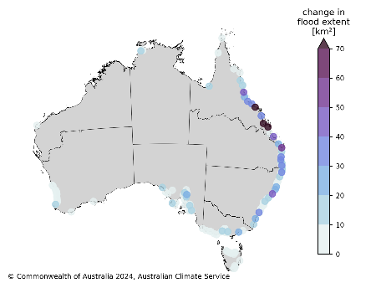
Consistently plot many hazards
[github link]

Slide 6
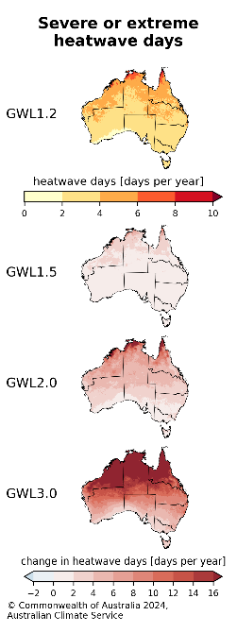
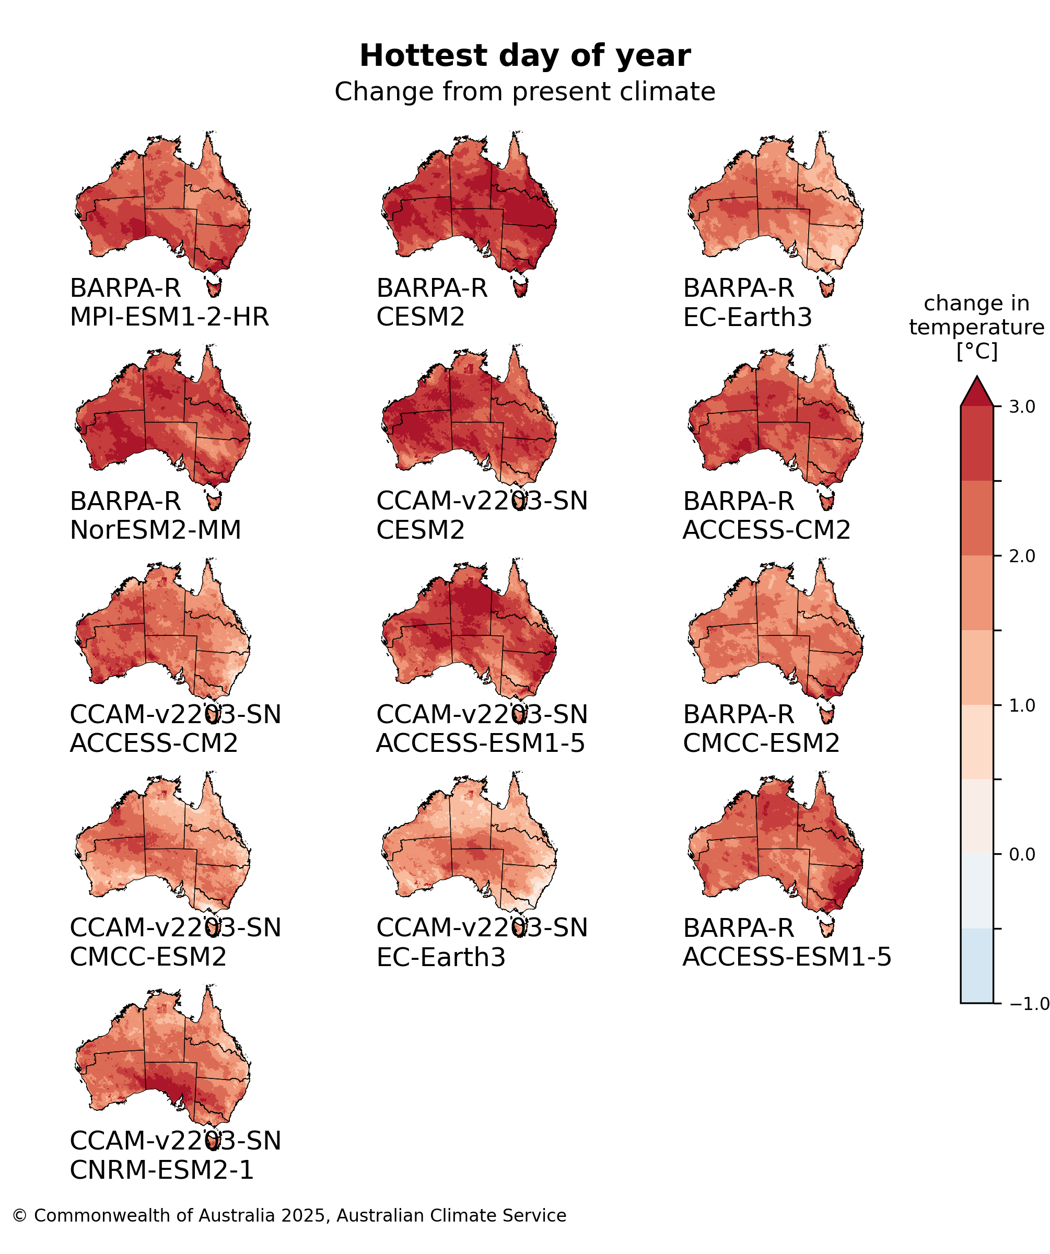
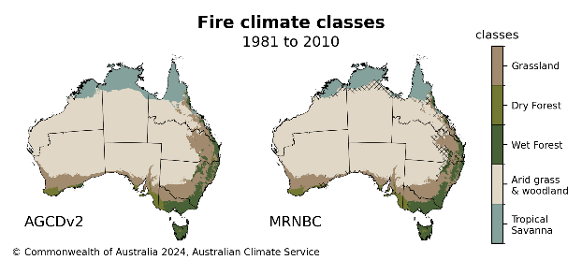
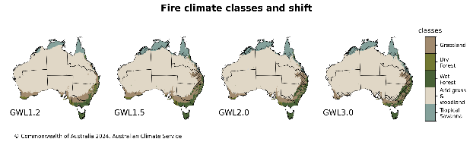
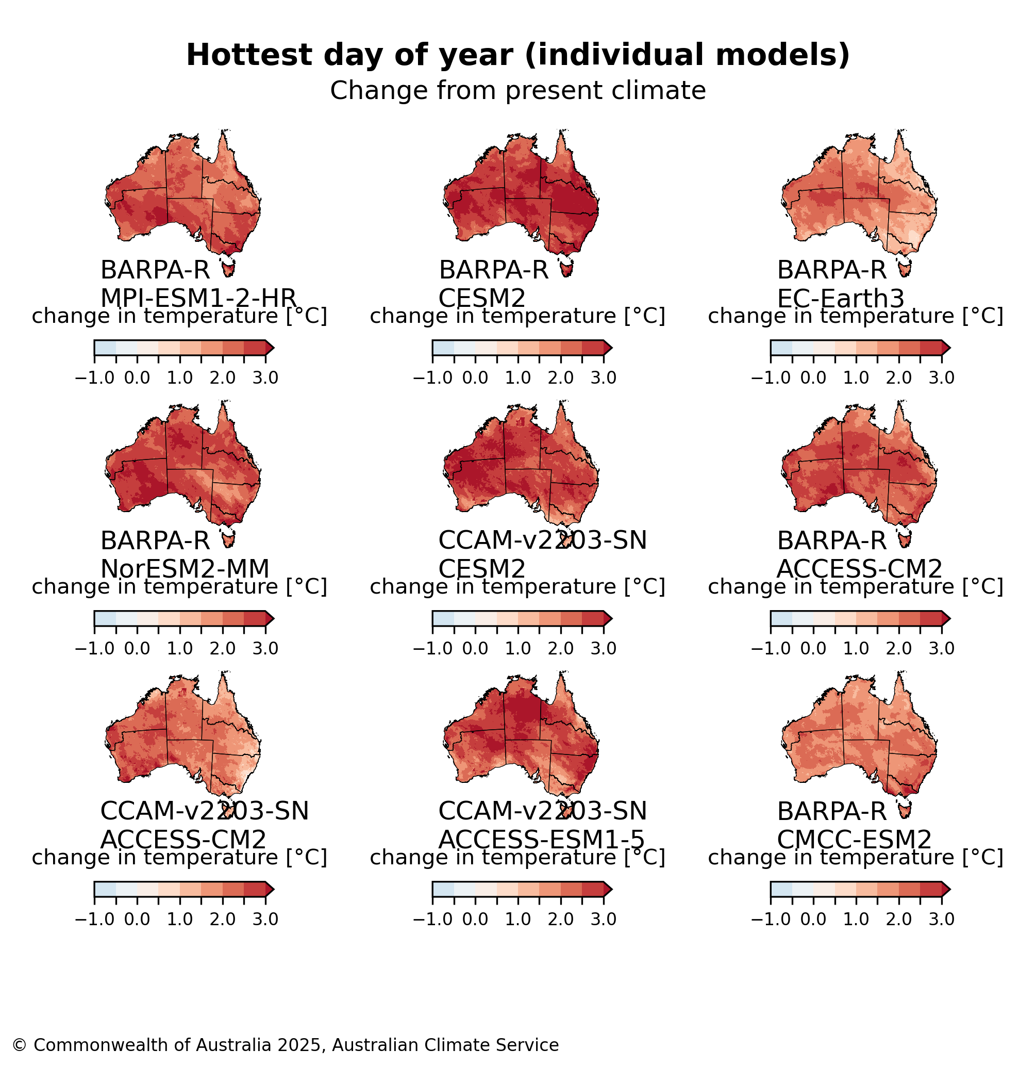
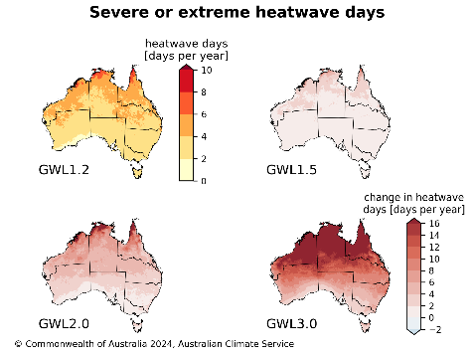
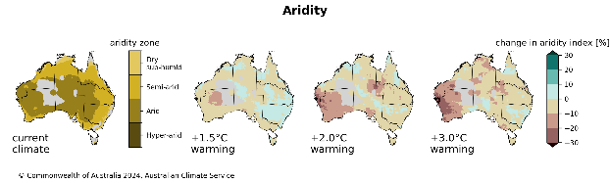
Plot multiple panels
[github link]

Slide 7
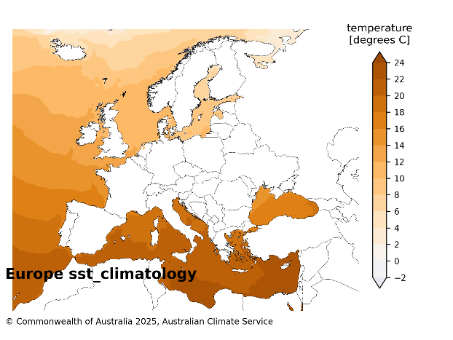
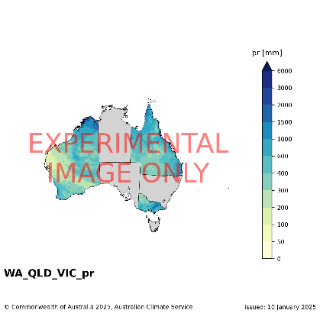
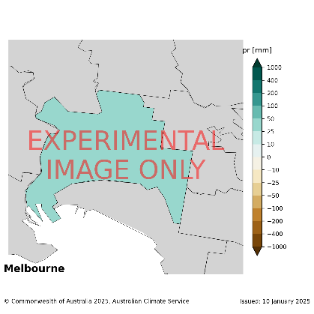
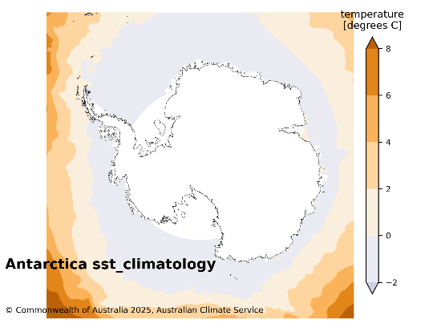
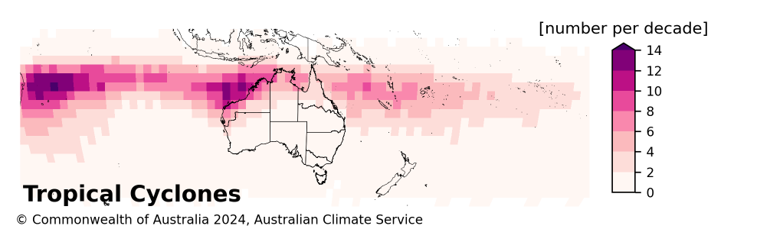
Plot other regions
[github link]
[github link]
[github link]

Slide 8
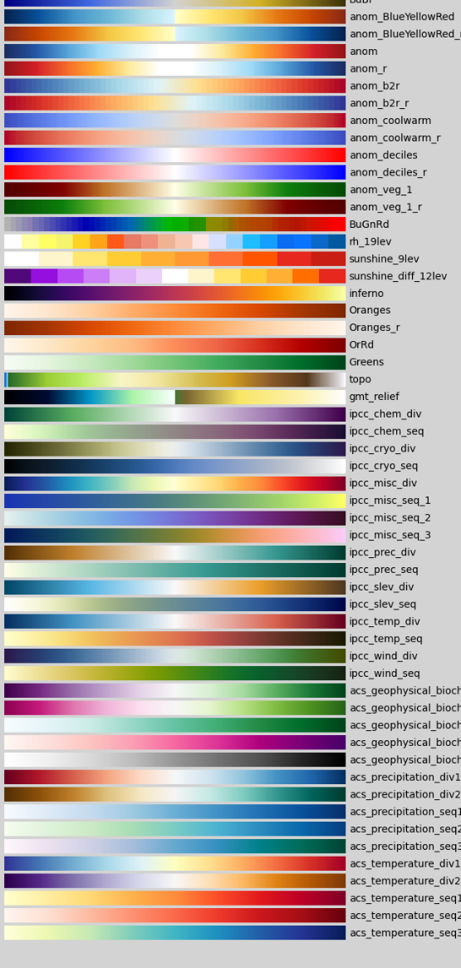
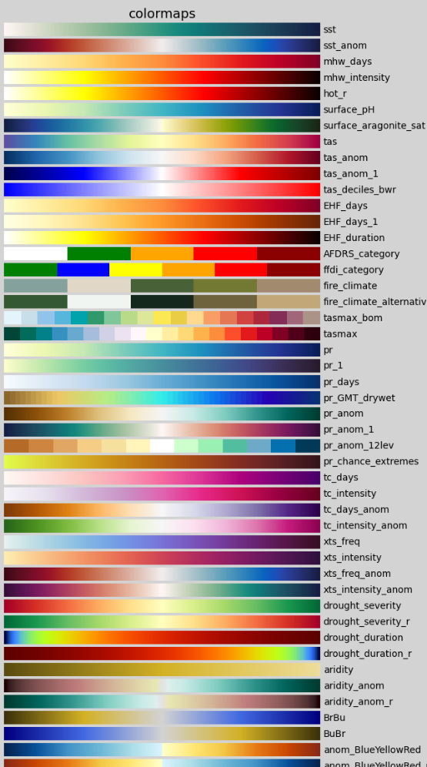
Colours and layout
Colours specifically chosen for climate hazards.
Colourscales follow IPCC design principles and ACS design guide (internal BOM document).
Subject matter experts gave guidance on common colourscales used in their field.
ACS has specific guidelines on figure layout and text label sizes etc.

Slide 9
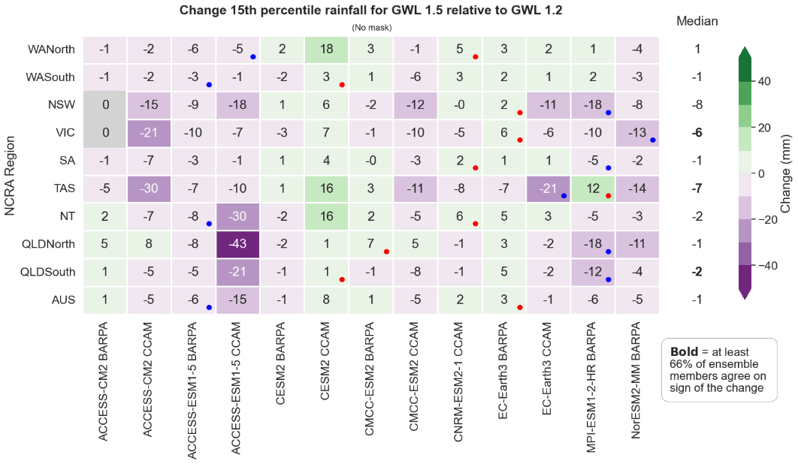
Area Statistics
Jessica Bhardwaj
Jessica Bhardwaj
 | Current | Future change relative to current
 | +1.2 °C | +1.5 °C | +2.0 °C | +3.0 °C
Number of severe and extreme heatwave days | 4 days [3, 5] | +2 [+1, +2] very high confidence | +5 [+3, +7] very high confidence | +14 [+7, +21] very high confidence
Hottest day of the year (Australia-wide average) | 43.7 °C [43, 44] | +0.5 °C [+0.1, +0.7] very high confidence | +1.1 °C [+0.7, +1.3] very high confidence | +2.3 °C [+1.6, +2.9] very high confidence
Summarise areas (NCRA or any custom mask)
Easily compare GWLs
Easily compare models
Heatmap visualisation developed by Jessica Bhardwaj [github link]

Slide 10
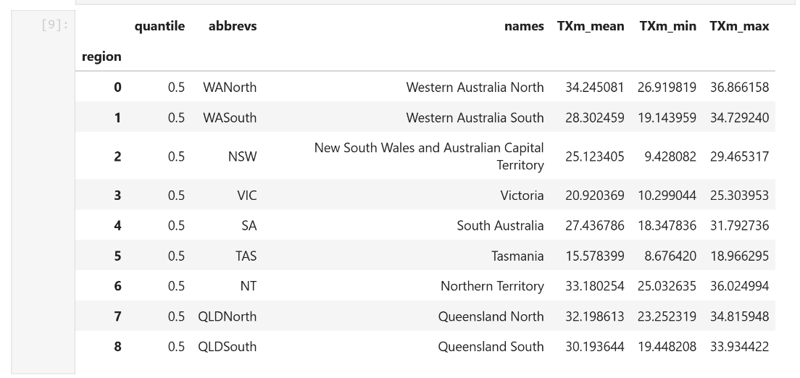
Area Statistics
Summarise hazard data with many statistics including:
'mean’,
'median’,
'mode’,
'min’,
'max’,
'sum’,
'std’,
'var’,
'proportions’,
'p10', and 'p90' (any pxx where xx is between 0 and 100).

Slide 11
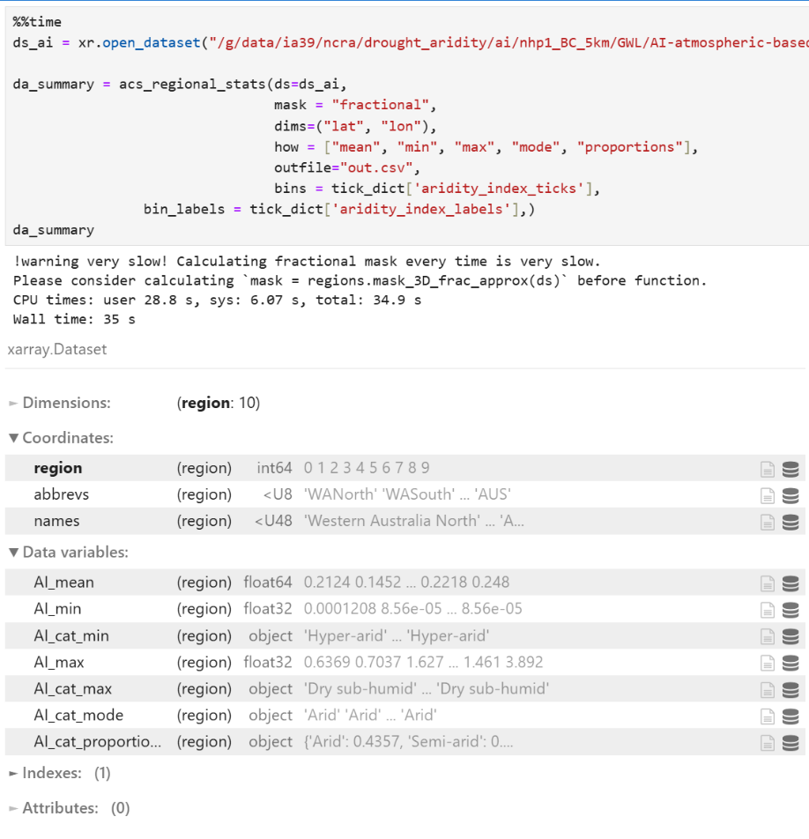
Stats for categorical data
Different data types need different statistical functions
Data types considered include:
Numerical
Continuous
Ordinal
Categorical
Non-finite (NaN, inf, etc)
[github link]

Slide 12
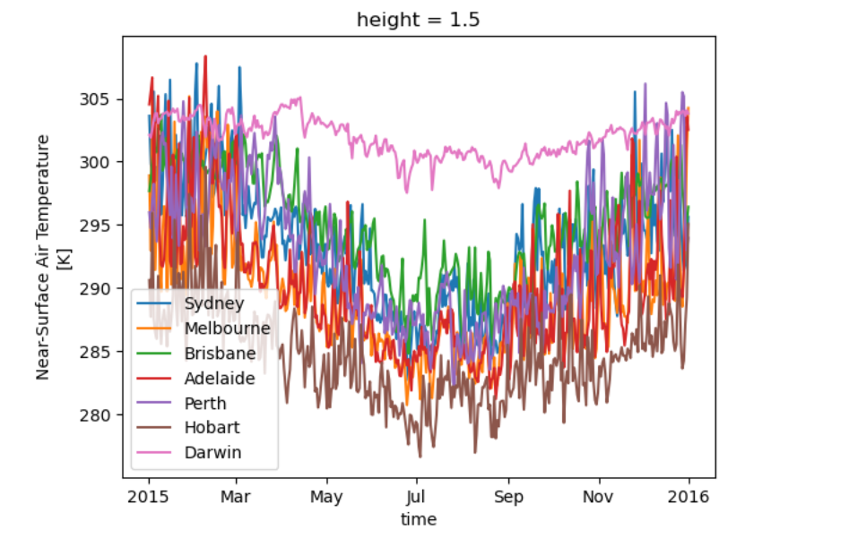
Time series for any region
Use acs_regional_stats to extract area averaged time series for any area
Default is NCRA regions
Here’s a snapshot for a list of LGAs

Slide 13
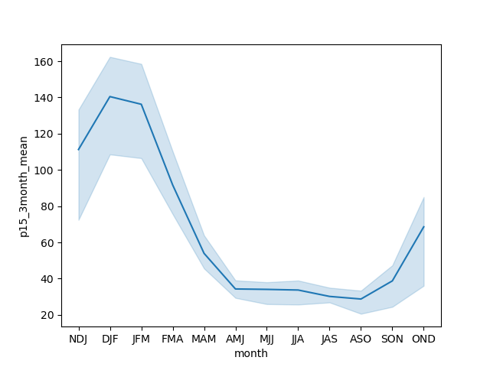
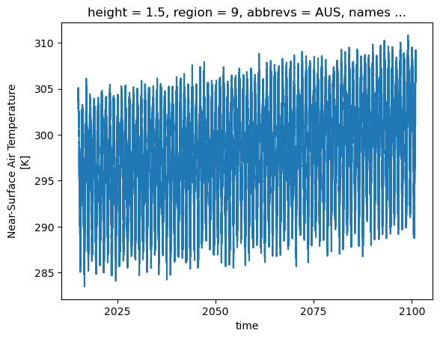
Multidimensional area stats
Extract area averaged daily time series from many files
Create climatologies
Compare ensemble members
[github link]

Slide 14

Recent improvements
Faster
Rotated and alternating ticks
Memory management for area stats
Any mxn arrangement

Slide 15

More to do
Increase automation
Data management
Better plotting for non-Australia-wide plots
Enable parallelisation
mxn plots with different colour scales
Increase functionality
Release “version”
Make your own suggestions!

Slide 16
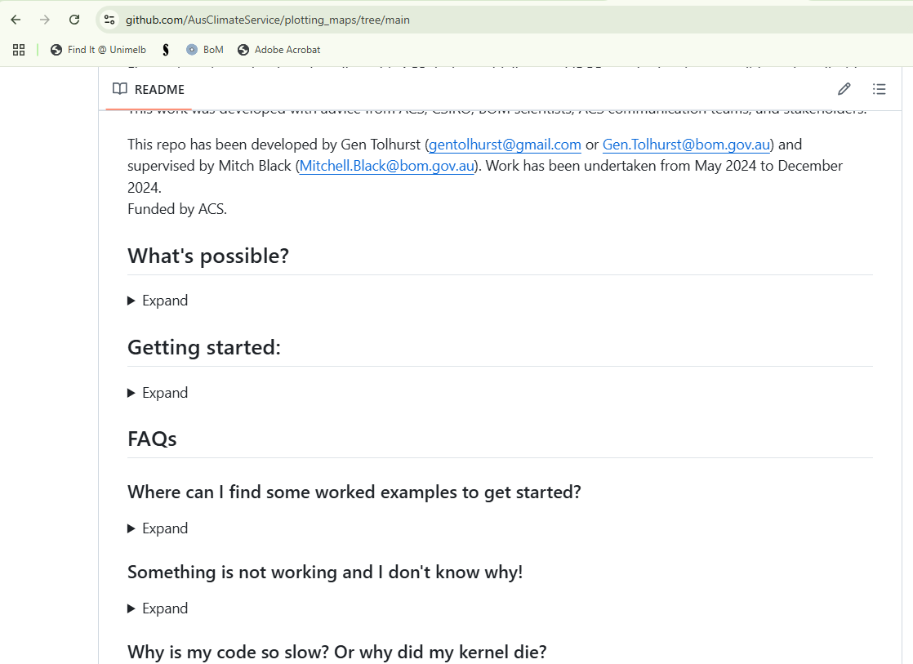
Where to find more info
Readme
Examples
Reports
Docstrings
Your colleagues – this has been a team effort and collaboration

